Slide 1
SNPWG Questionnaire Items
Compare with
Japanese Sailing Directions Items

Slide 2
General of Japanese Sailing Directions
History
JHOD is publishing the Sailing Direction from 1892.
Publish area.
5 division areas.
Coast of Hokkaido.
South East Coast of Honshu.
North West Coast of Honshu.
Seto Naikai
Coast of Kyushu.

Slide 3
Contents
Part 1 General information.
This part contains general remarks concerning the each areas.
Part 2 Offshore and through routes.
This part covers mainly passages.
Part 3 Coastal routes and harbours.
This part describes coastal features, port and harbours.

Slide 4
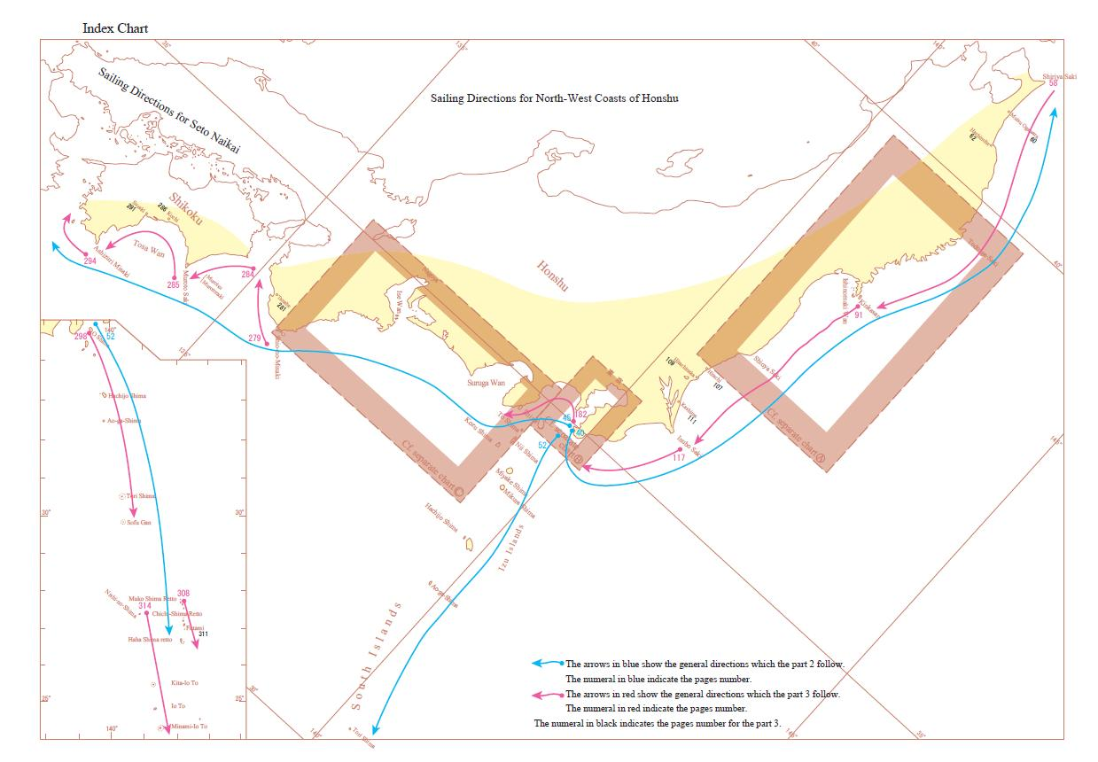
Index Chart
C
B
A

Slide 5
